Slide 1
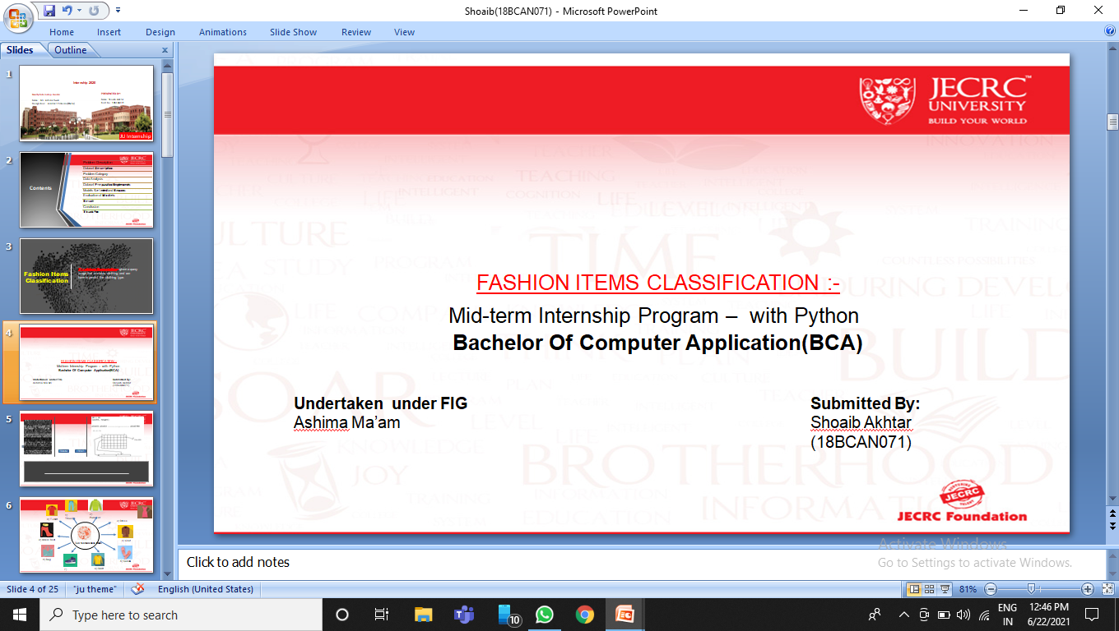
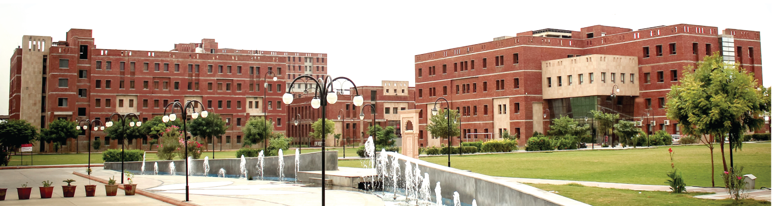
GUIDED BY :
Name: Mr. Harshit Sharma
Designation: Assistant Professor(IT&CA)
PRESENTED BY:
Name: Prakhar Saxena
Yuvraj Singh
Maha Aryaman Singh
“RoadRash-3”

Slide 2
Unity Engine
Unity is a cross-platform game engine developed by Unity Technologies
The engine has since been gradually extended to support a variety of desktop, mobile, console and virtual reality platforms
It is particularly popular for iOS and Android mobile game development and is considered easy to use for beginner developers and is popular for indie game development.

Slide 3
Unity Assets Store
The Asset Store is home to thousands of free or affordably priced assets that save critical time and effort for Unity creators
Both Unity Technologies and members of the community create these Assets and publish them to the store.
There are various types of Assets in the store ranging from textures, animations and models to entire Project

Slide 4
Unity Presets
Presets are assets that you can use to save and apply identical property settings across multiple components, assets, or Project Settings windows.
You can also use Presets to specify default settings for new components and default import settings for assets in the Preset Manager The Preset Manager supports any importers, components, or scriptable objects you add to the Unity Editor.
You can only apply Presets in the Editor. Presets have no effect at runtime. You can use scripting to support presets in your own Monobehaviour, ScriptableObject or ScriptedImporter classes.

Slide 5
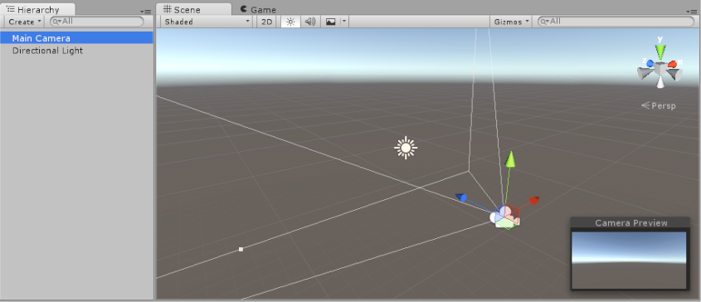
Unity Scenes
Scenes are where you work with content in Unity.
They are assets that contain all or part of a game or application.
When you create a new project and open it for the first time, Unity opens a sample scene that contains only a Camera and a Light.

Slide 6
Unity Hub
The Unity Hub is a management tool that allows you to manage all of your Unity projects and installations.
Use the Hub to manage multiple installations of the Unity Editor along with their associated components, create new Projects, and open existing Projects.

Slide 7
Scripts
Used a controller script for the movement of the car
Used a follow script for the camera to follow the car throughout the game
A path script for AI to follow some certain points.

Slide 8
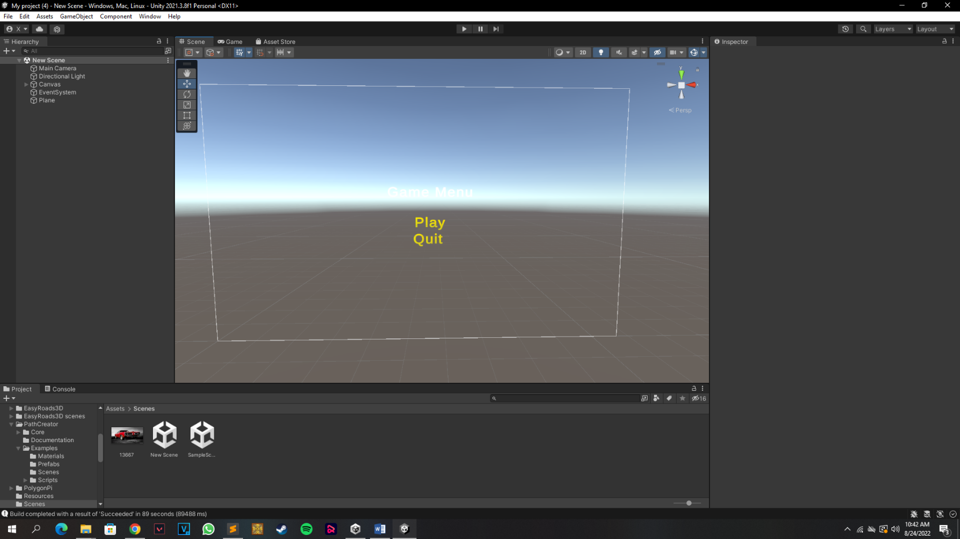
Menu Screen

Slide 9
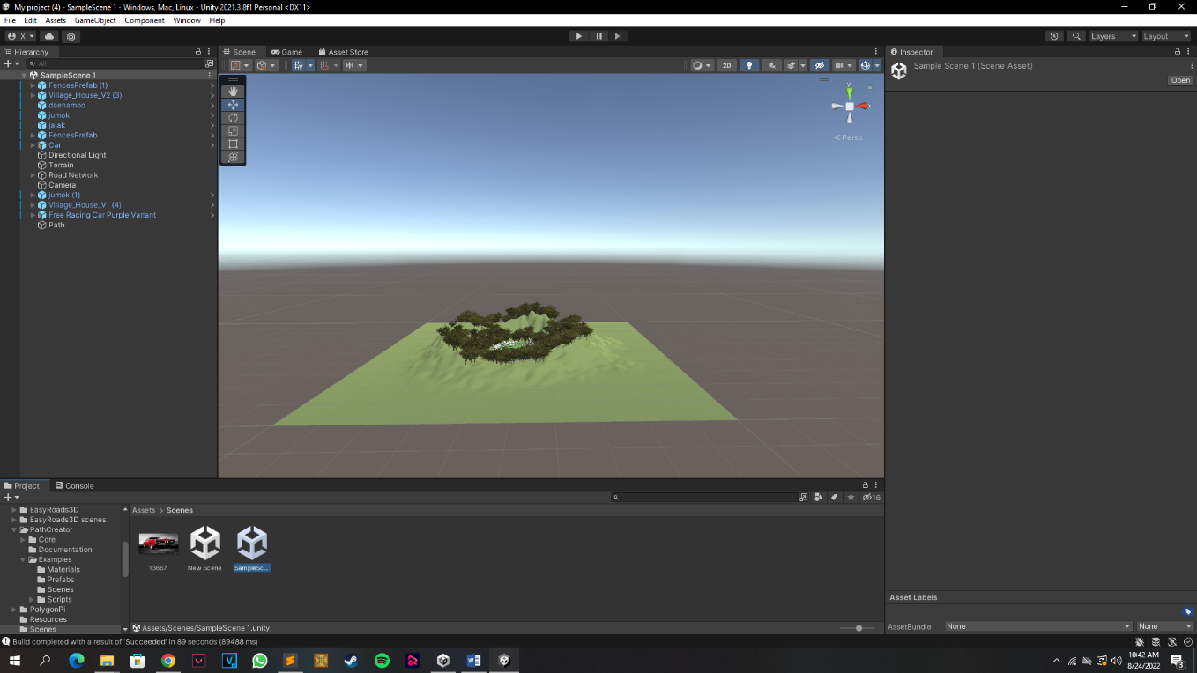
Main Game Scene
Main game scene contain all the presets and assets and scripts which are used to develop the graphics

Slide 10
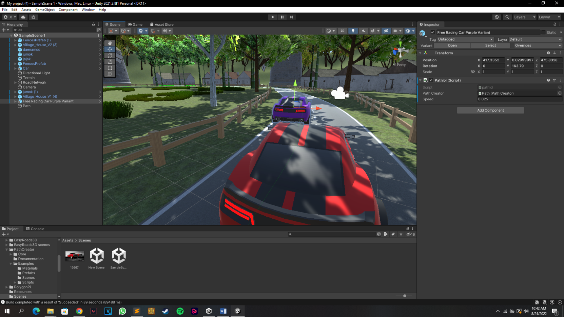
Cars

Slide 11
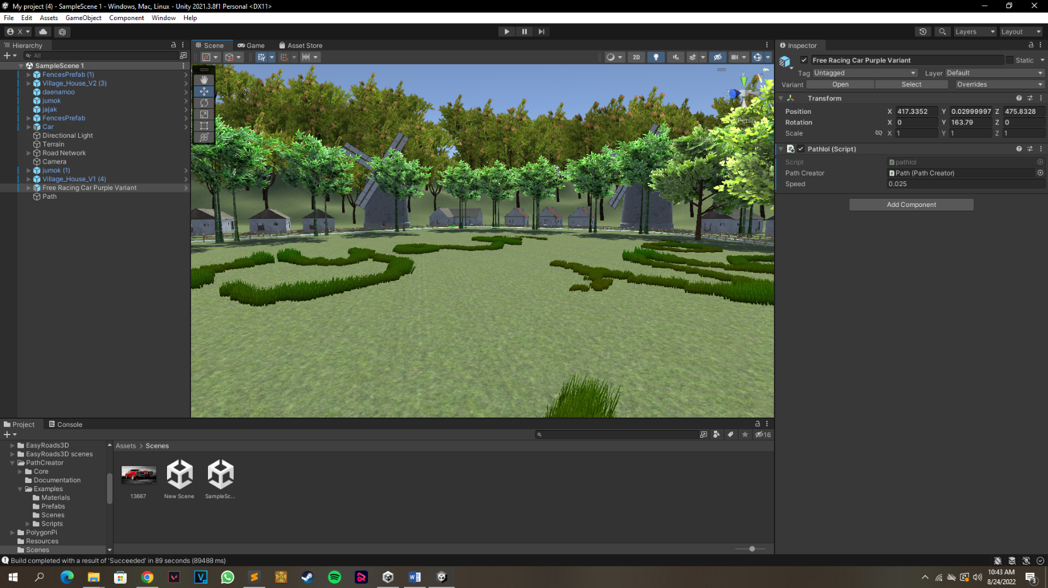
Buildings and terrain

Slide 12
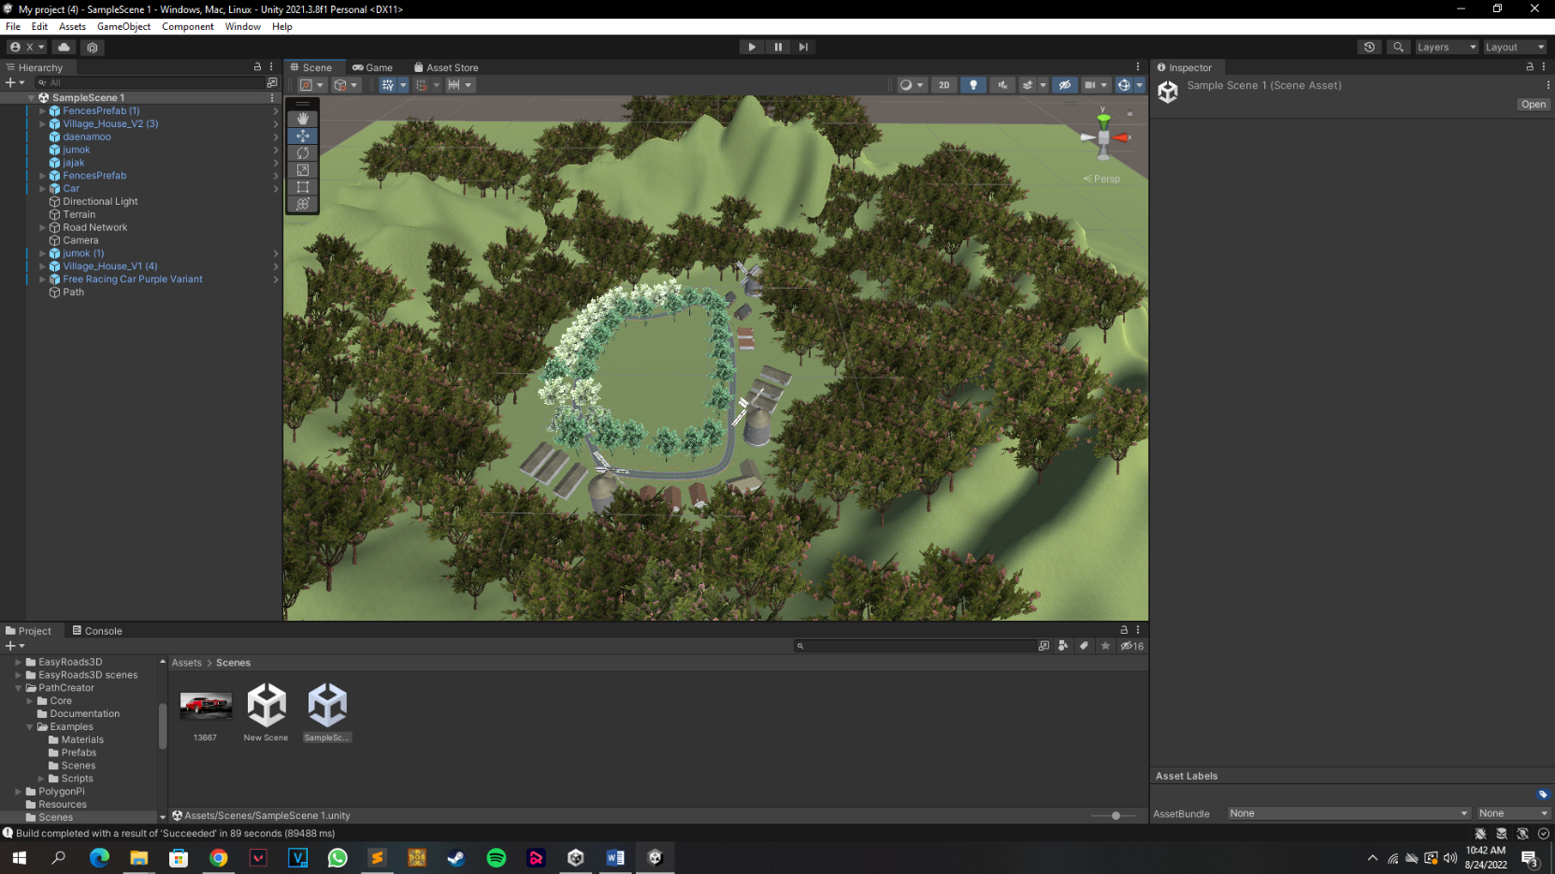
Full view

